Slide 1

Social Media Progress Report
Social Media Progress Report
Jehan Valera
June 21, 2018

Slide 2

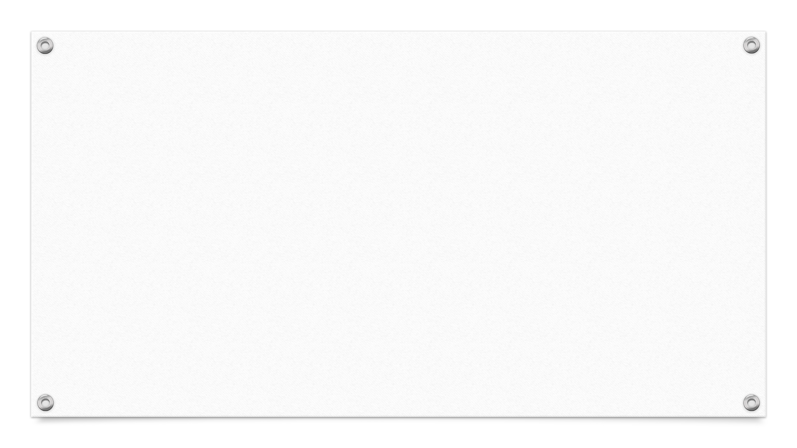
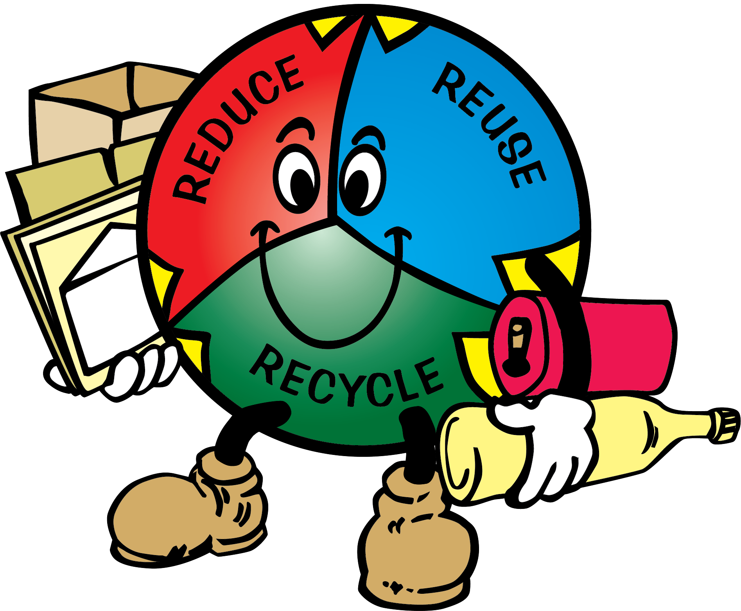
Goals
Increase SVR’s presence on social media
Increase public awareness
Encourage behavioral change
Educate

Slide 3




Strategies
Polish social media outlets
Push quality posts
Constantly be active on social media

Slide 4
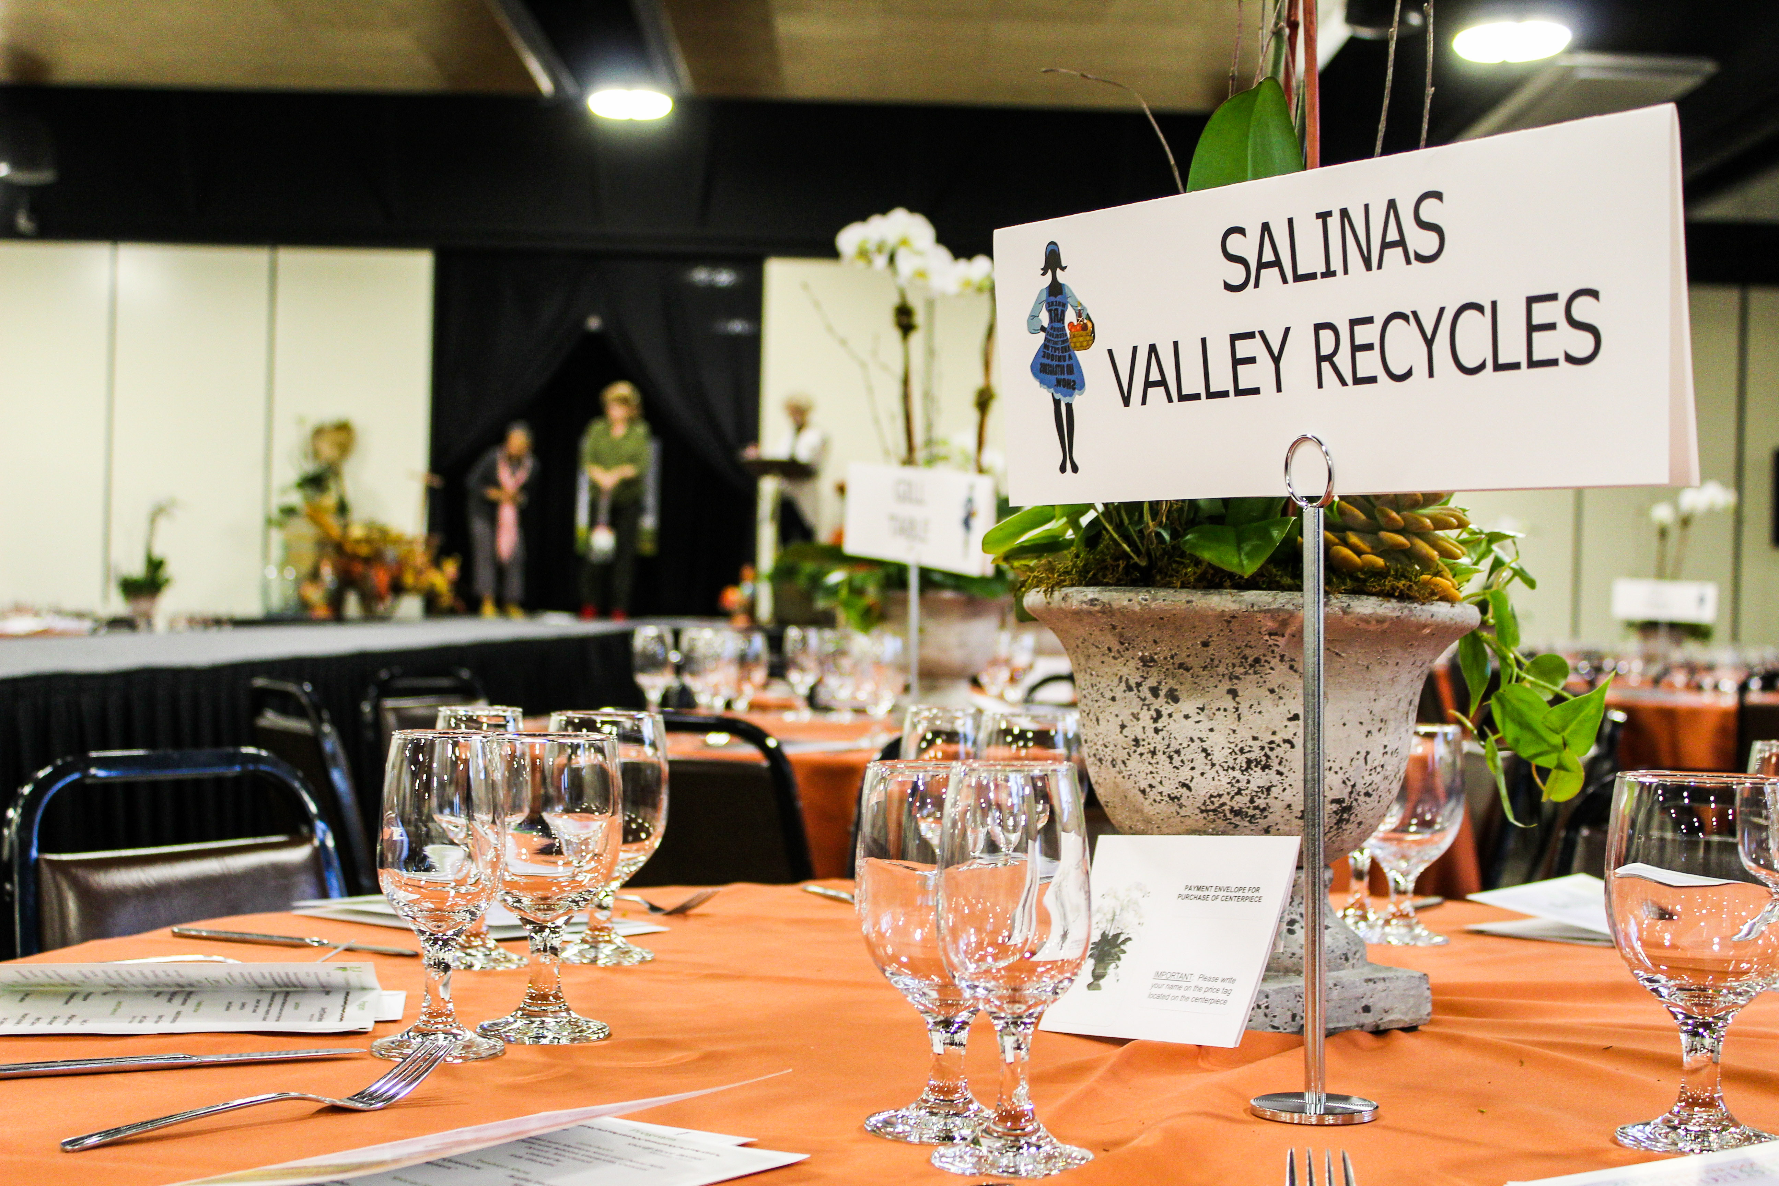
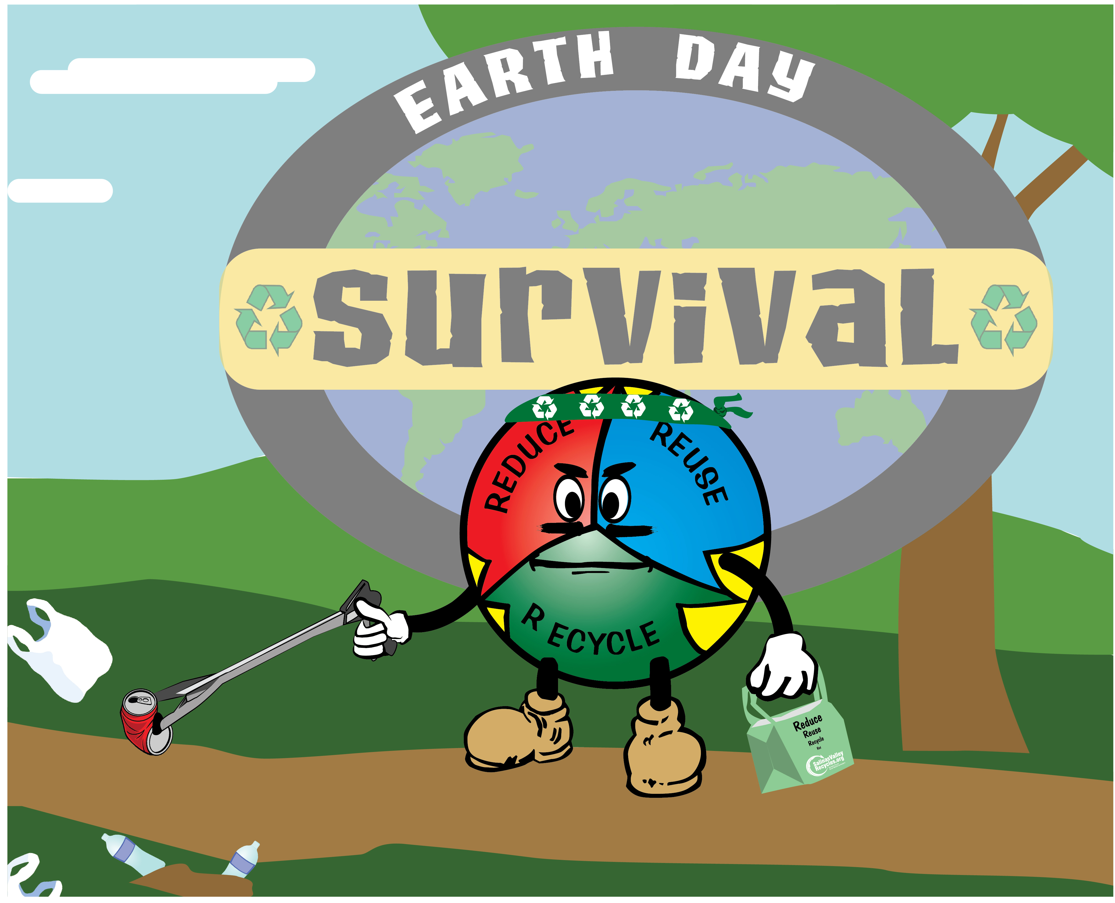
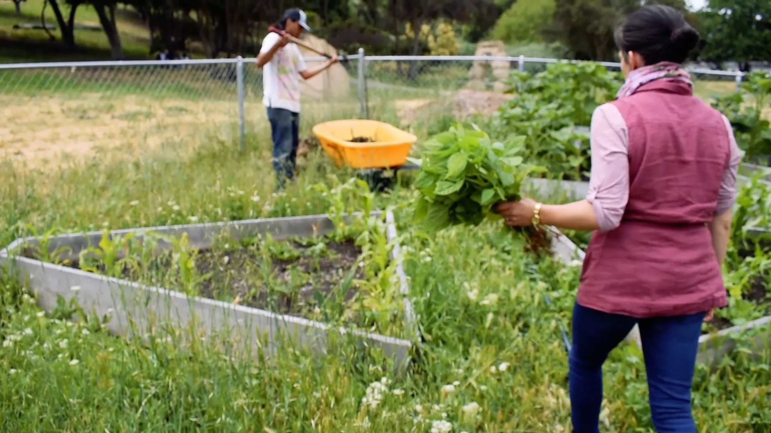
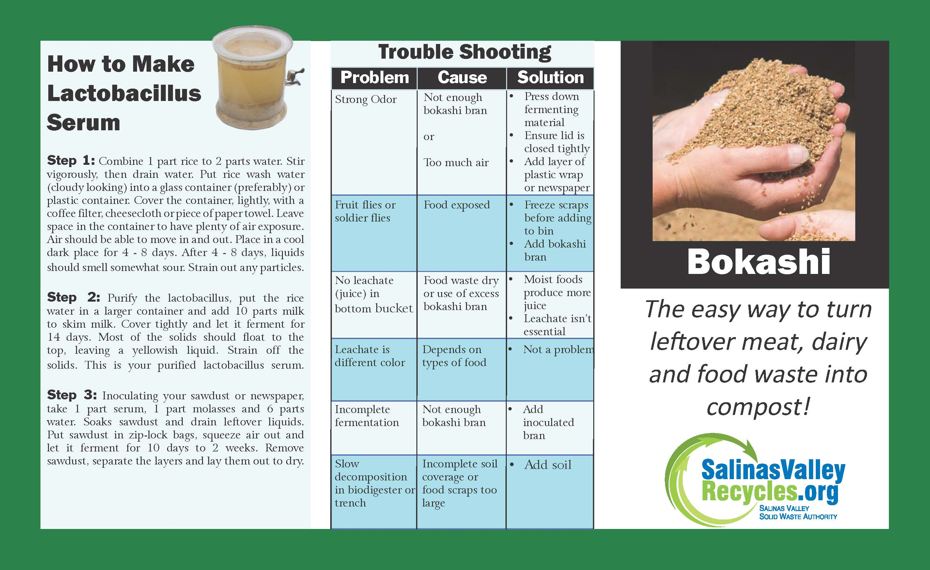
Projects
Time Lapse Video
Garden Video
Composting Brochure
Earth Day Wally
Photograph Events
Earth Day Giveaway
Site Map (WIP)
Mural Painting (WIP)

Slide 5
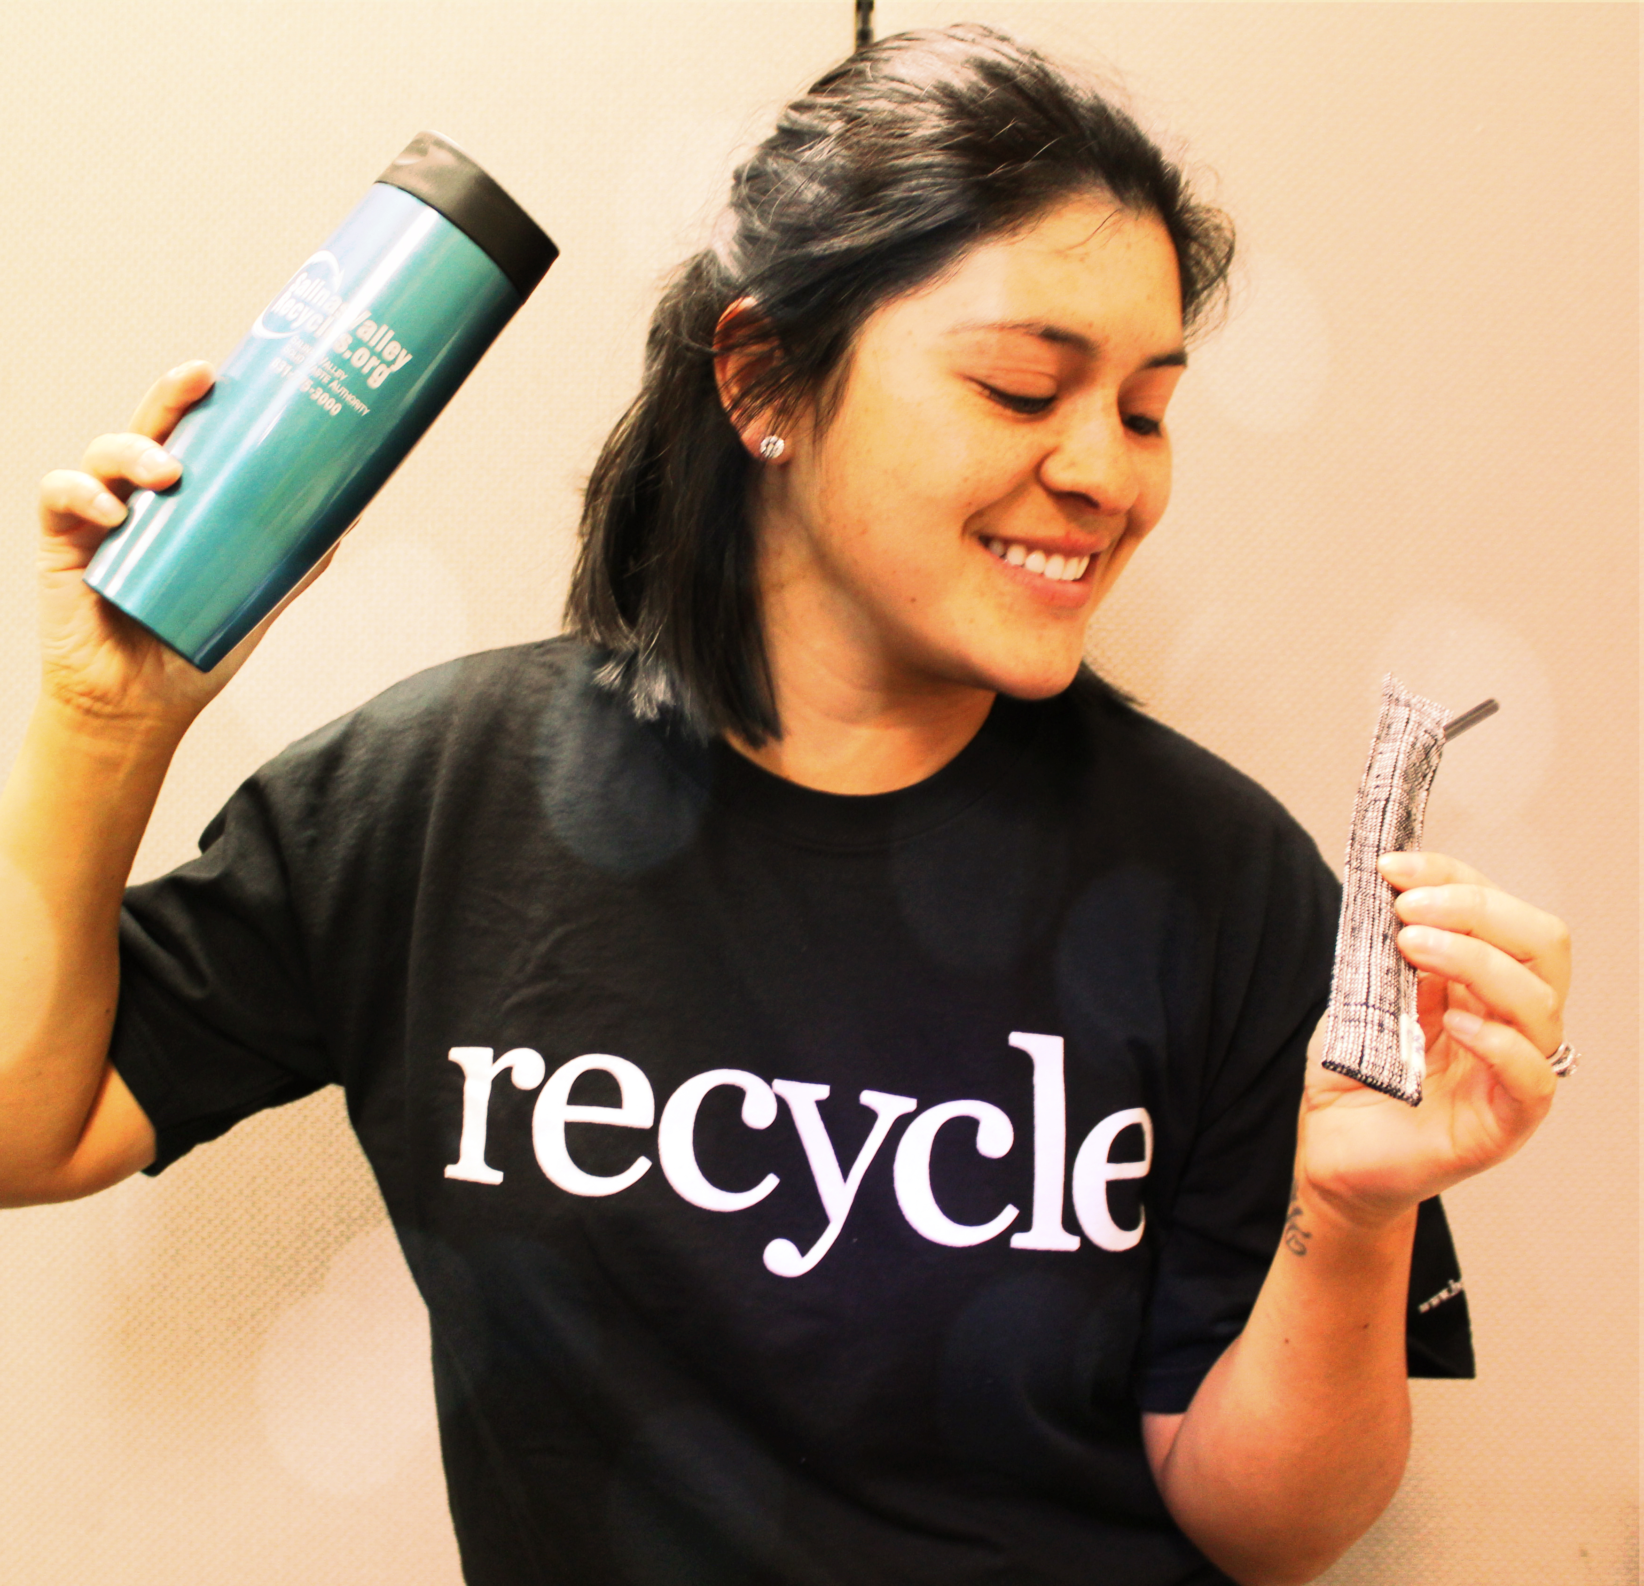
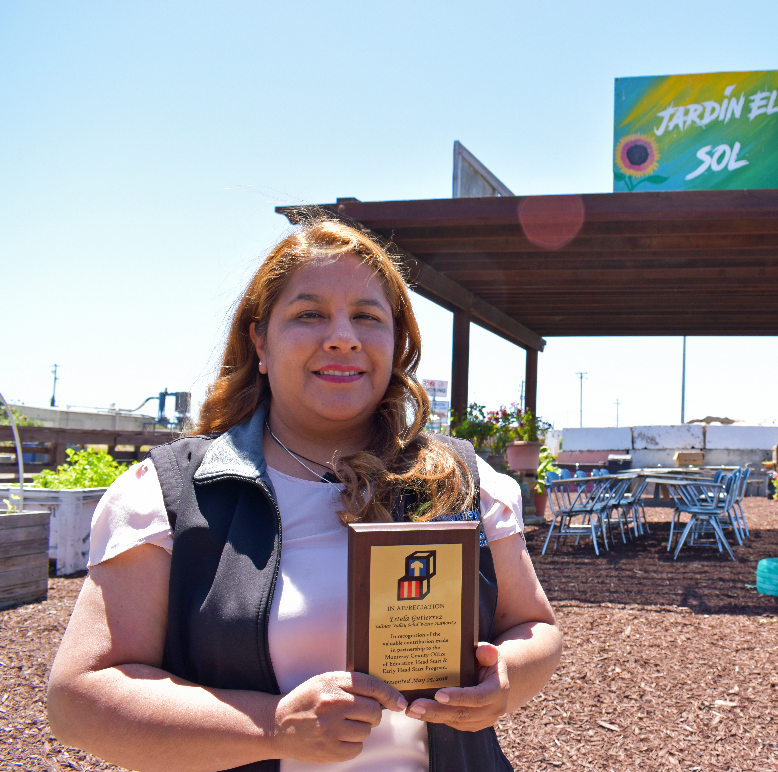
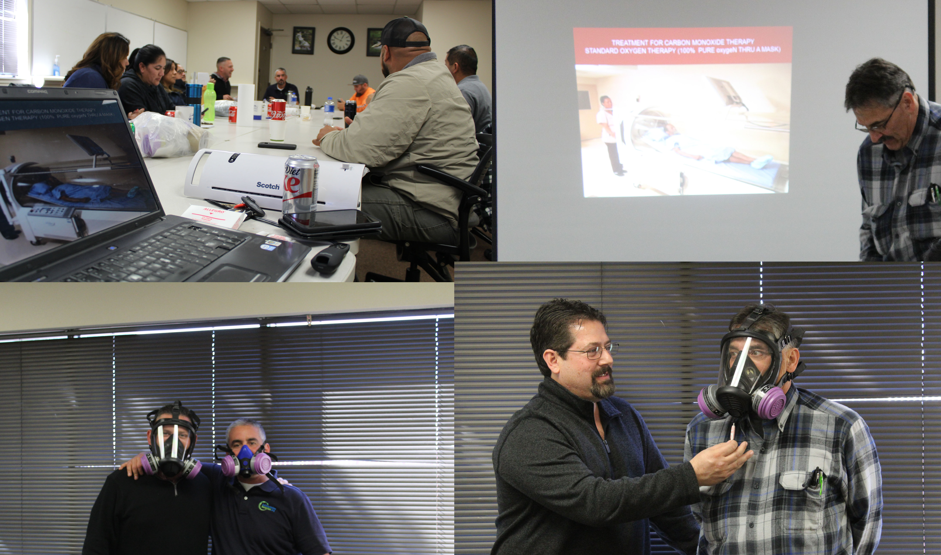
Social Media
Verified Facebook page
Changed Facebook page name
Added a few services on Facebook
Compared our page to other solid waste agencies.
Started following more related social media pages
Created yelp account
Corrected Facebook analytics
Started tracking analytics for Instagram

Slide 6
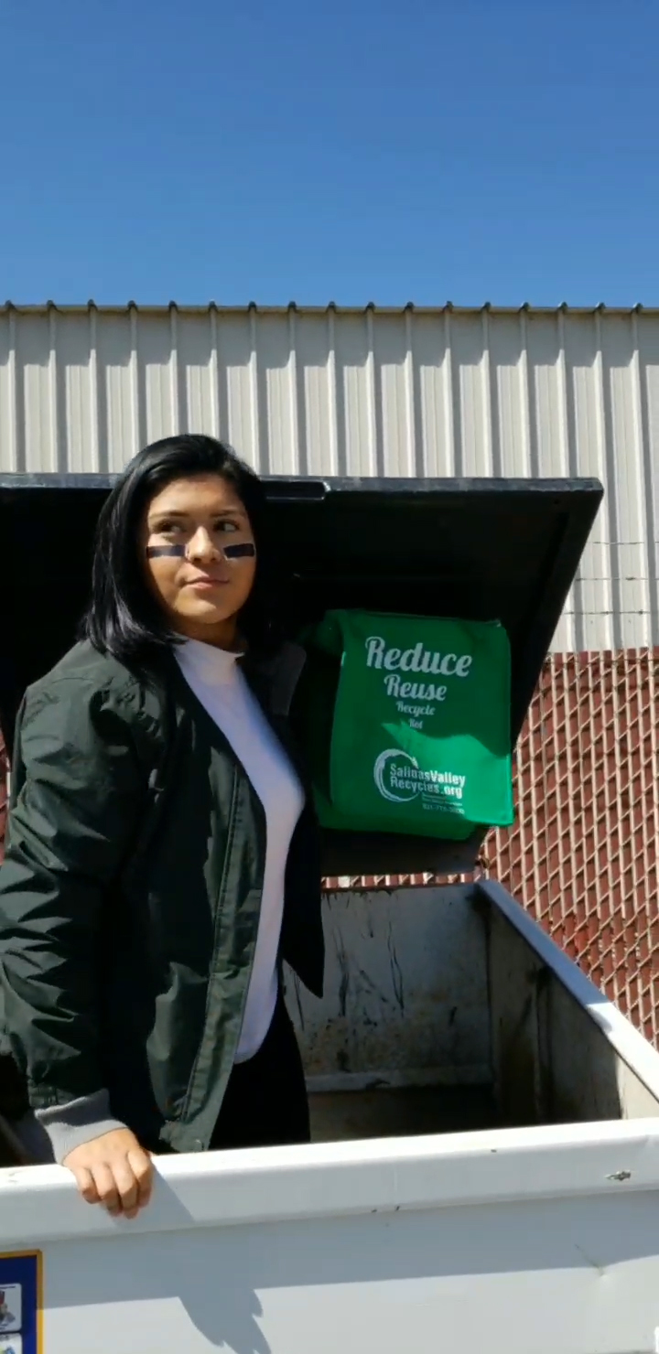
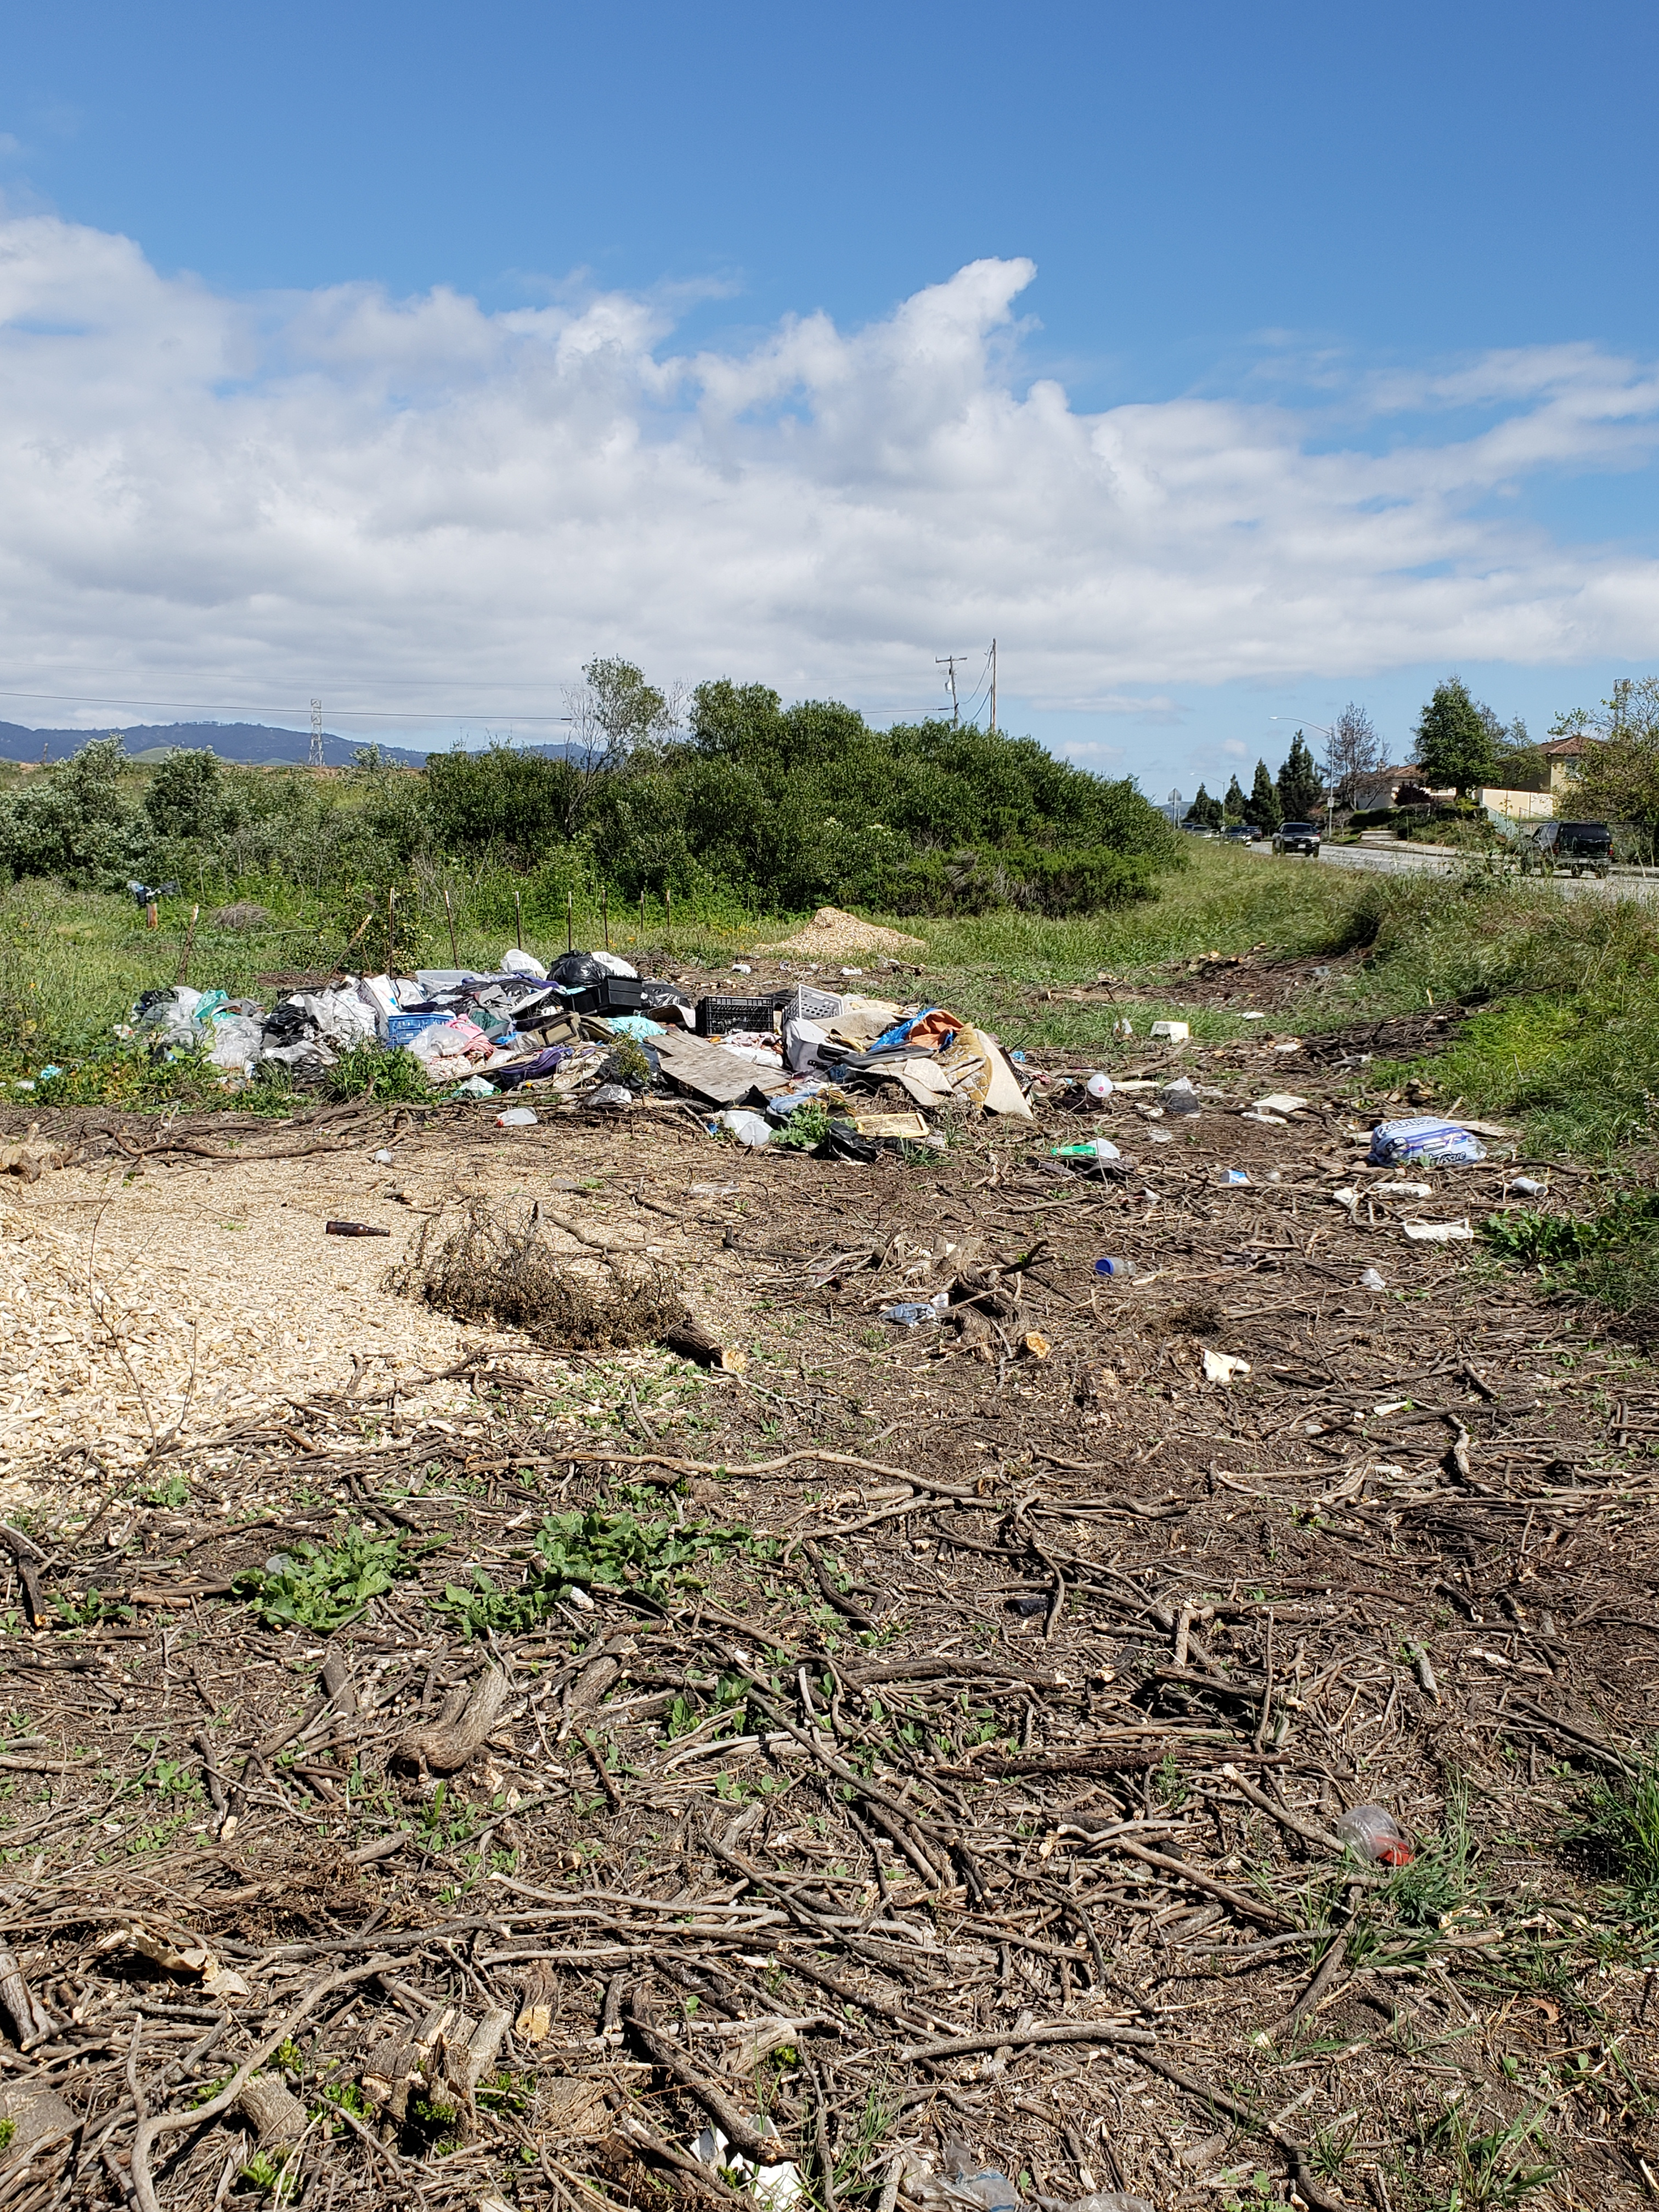
Social Media Statistics
Two popular posts in April

Slide 7
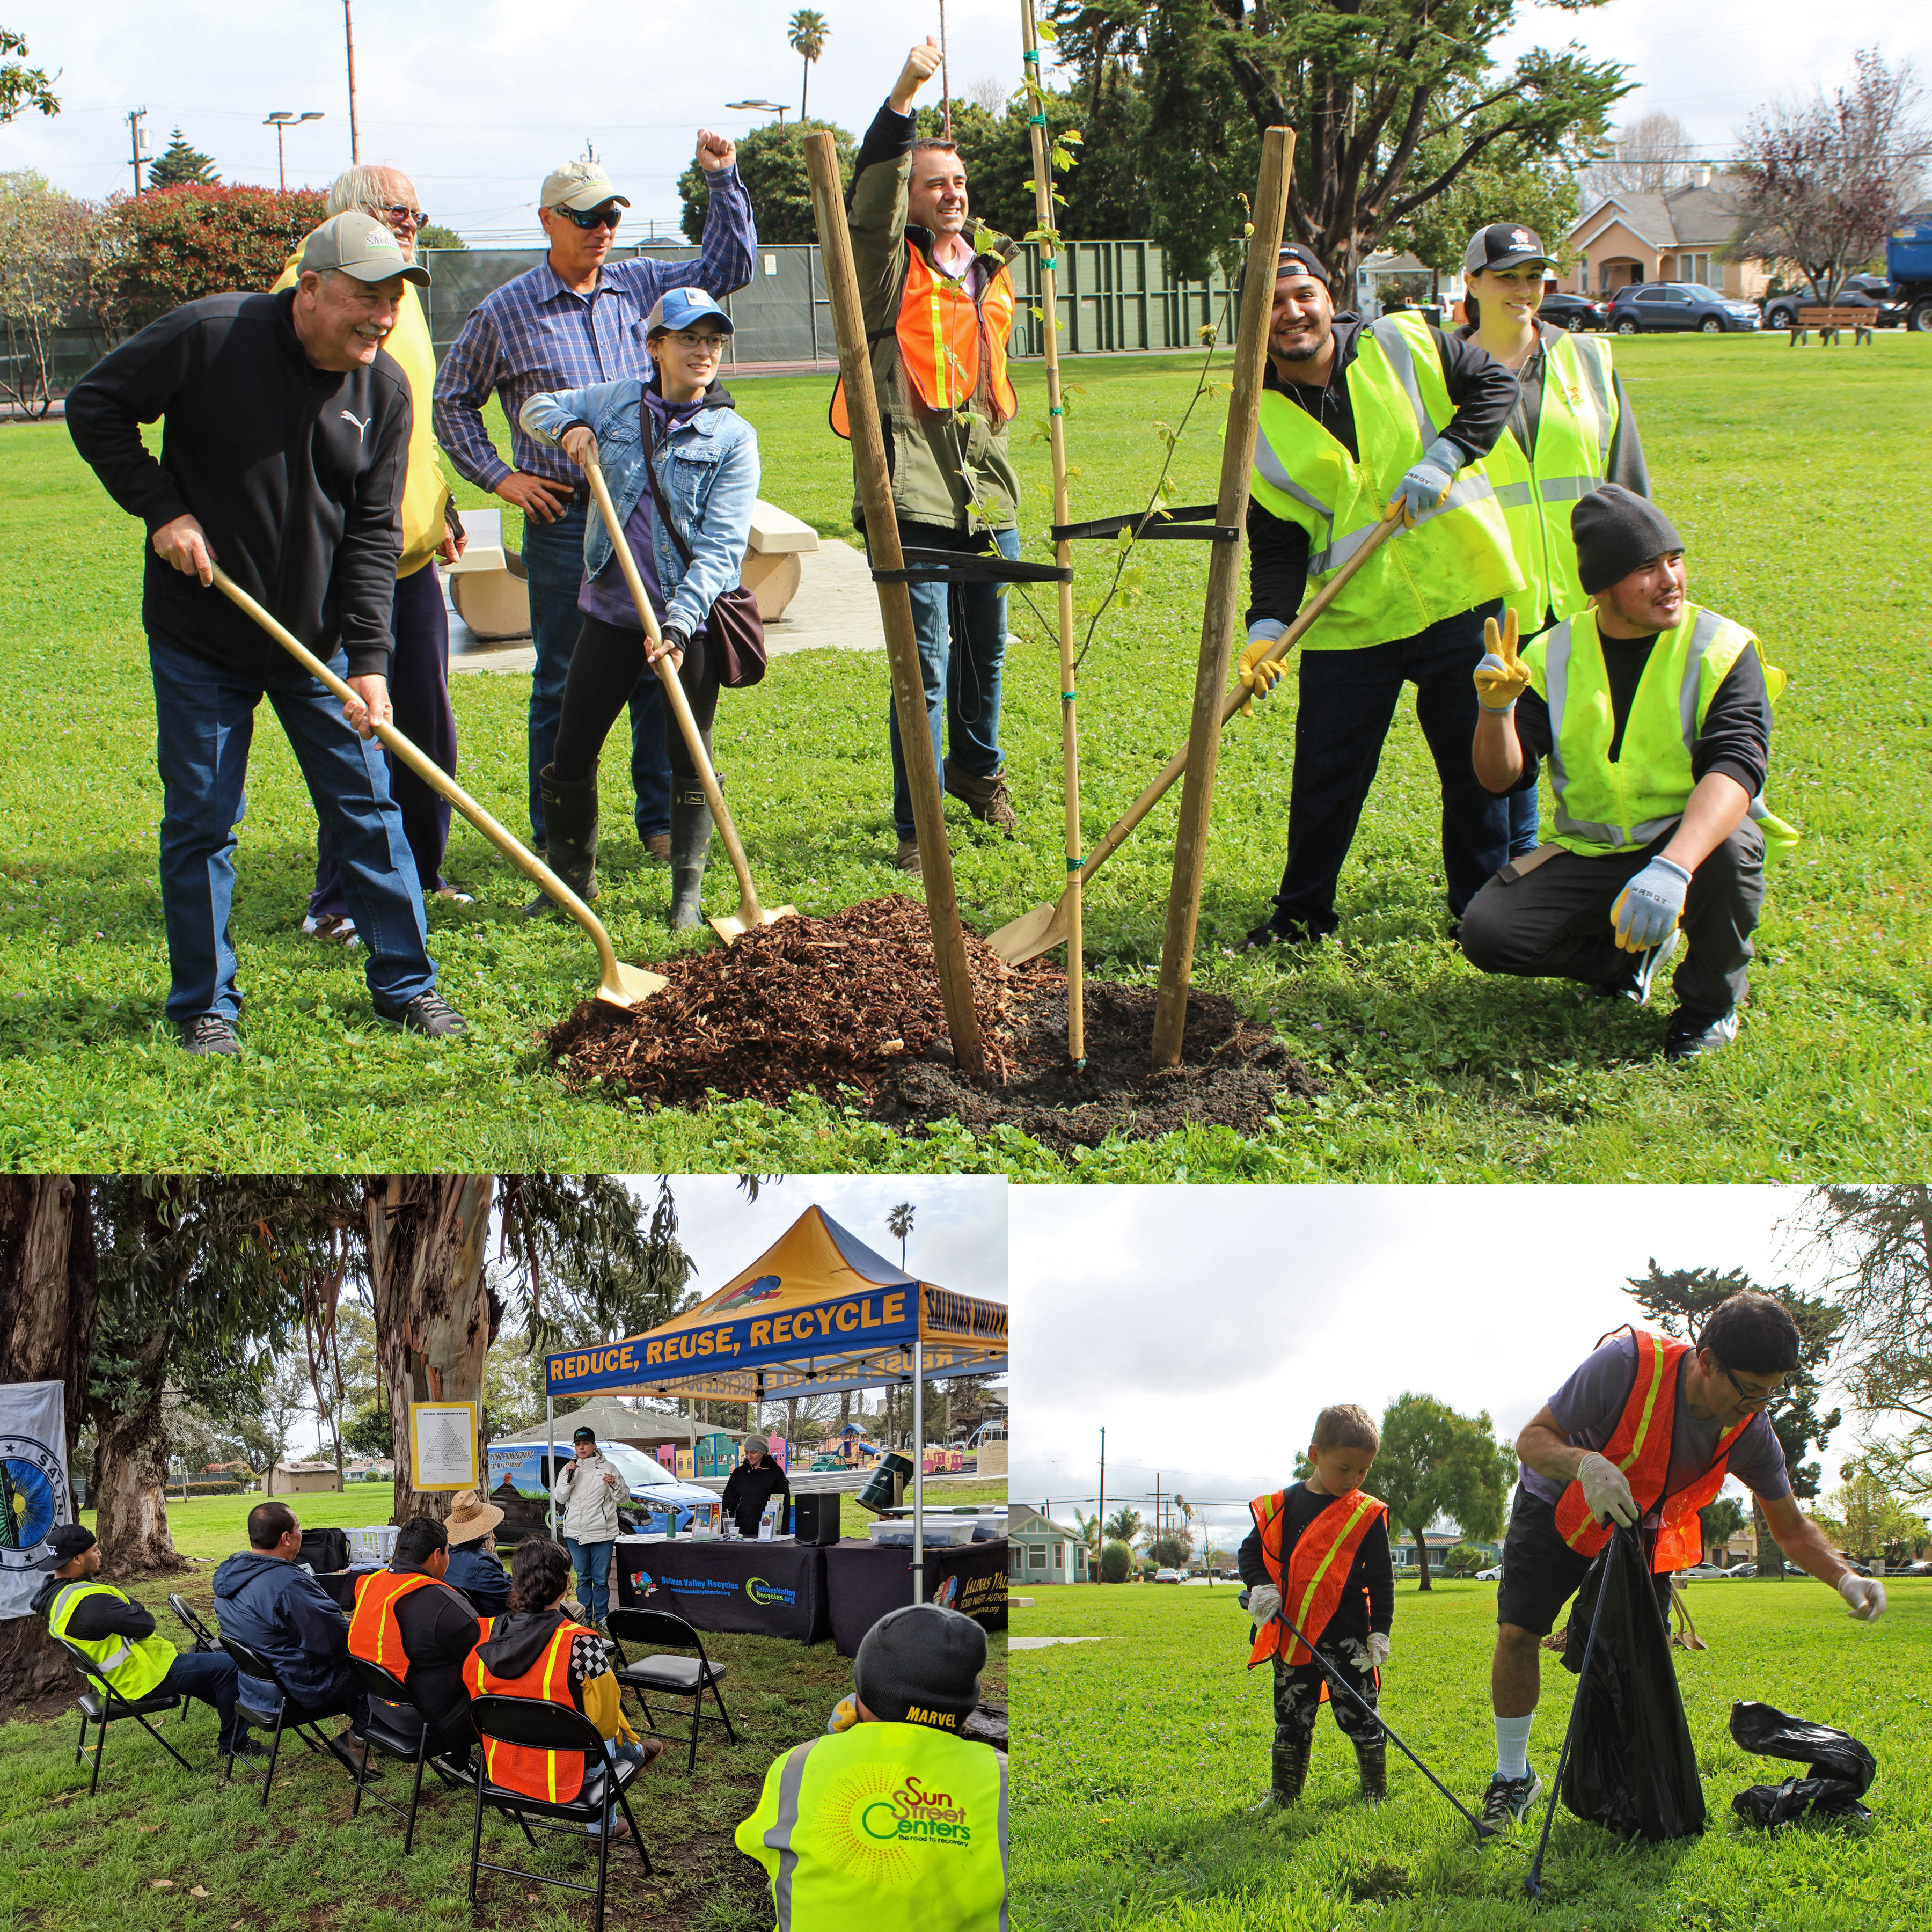

Social Media Statistics
Popular tweets of April and May
Impressions – The total number of times your post has been seen

Slide 8
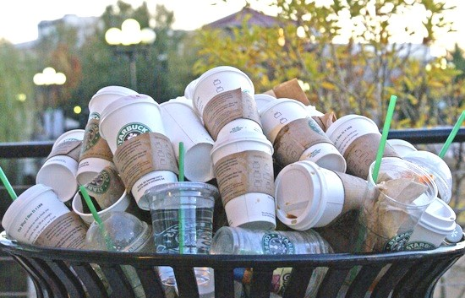
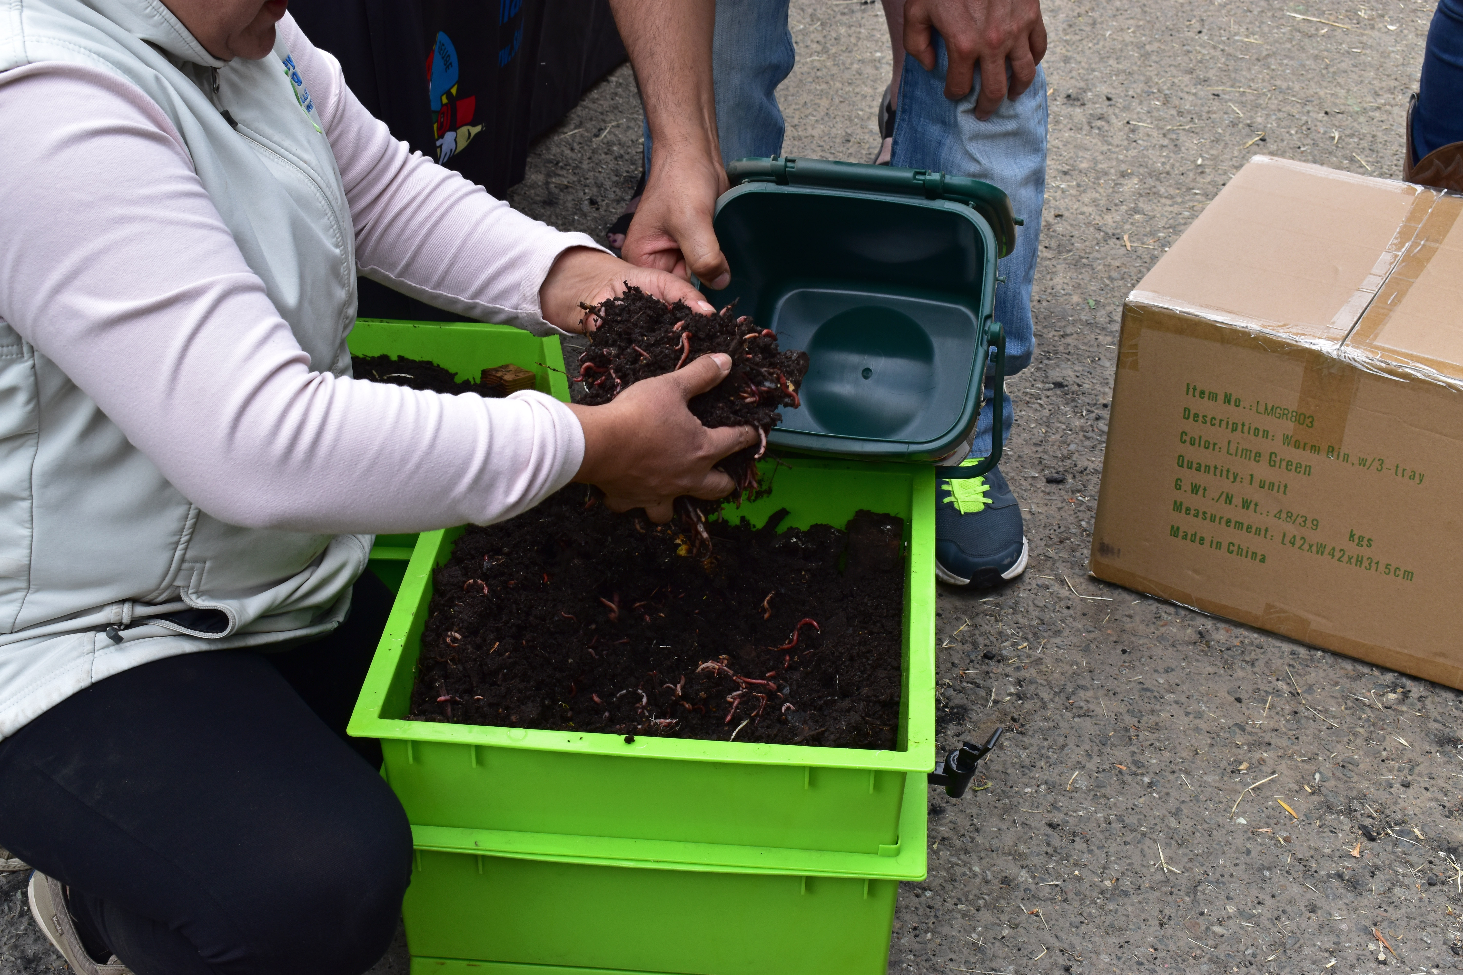
Social Media Statistics
Popular posts in May

Slide 9
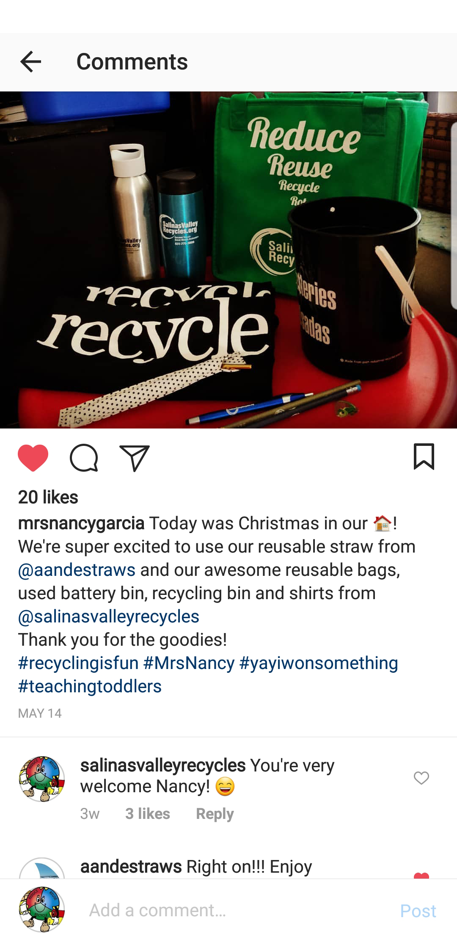
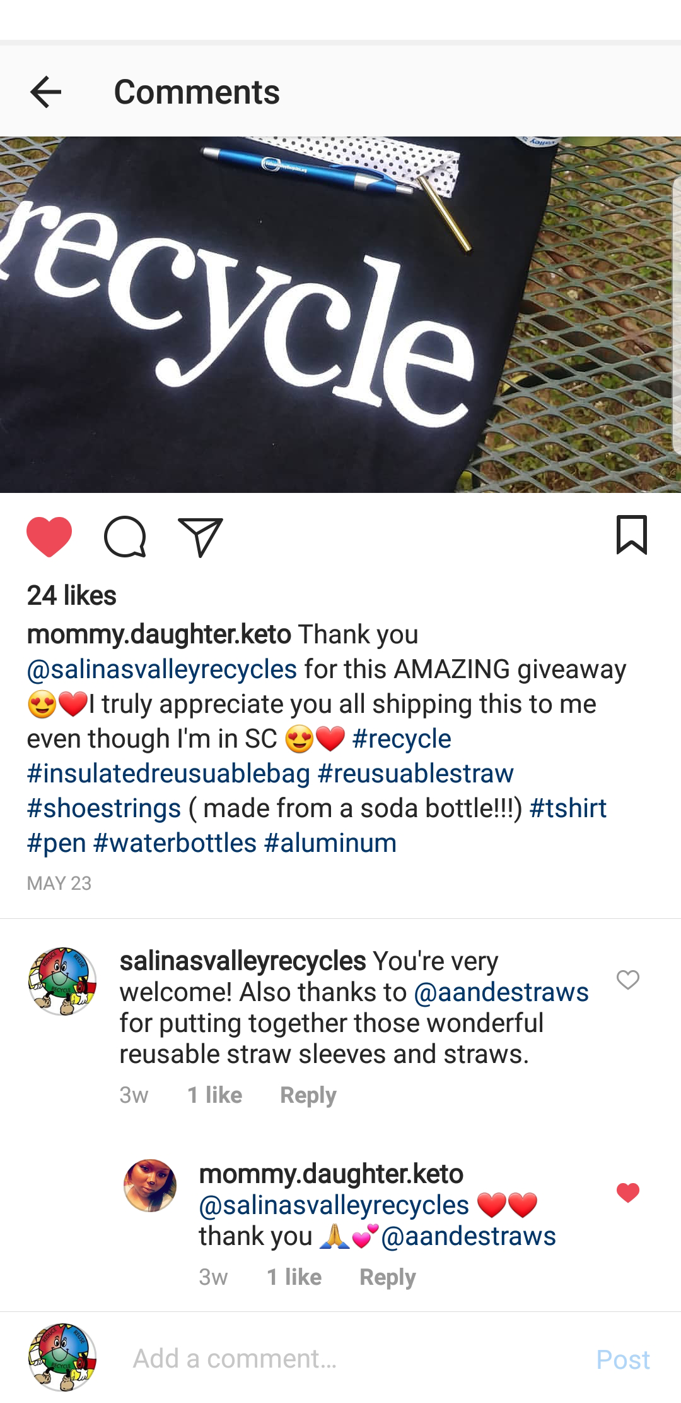
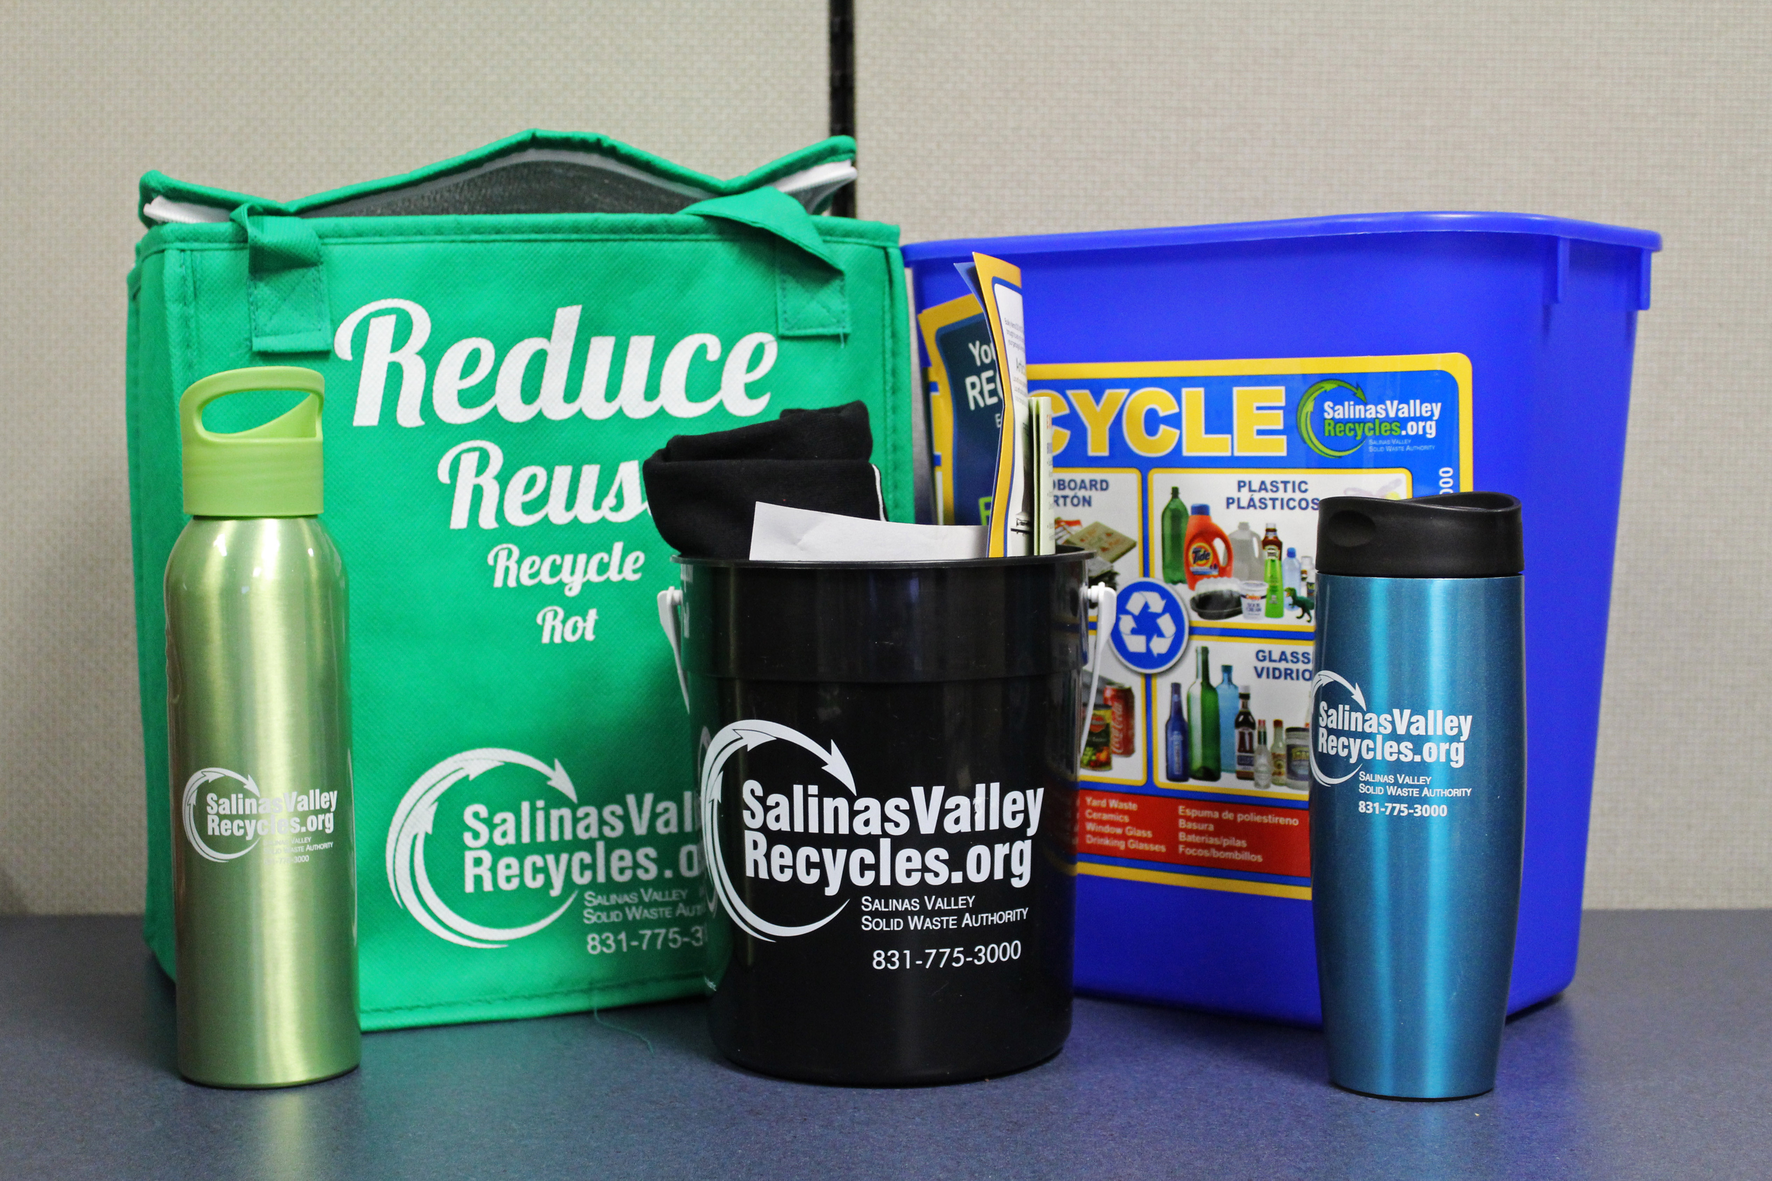
Social Media Campaigns
Earth Day Survival Kit Giveaway
Increase social media followers and engagement
Social media audience were asked to follow, comment and tag a friend.
Partnered with local social media influencer
Kit included items to start a waste reducing lifestyle

Slide 10
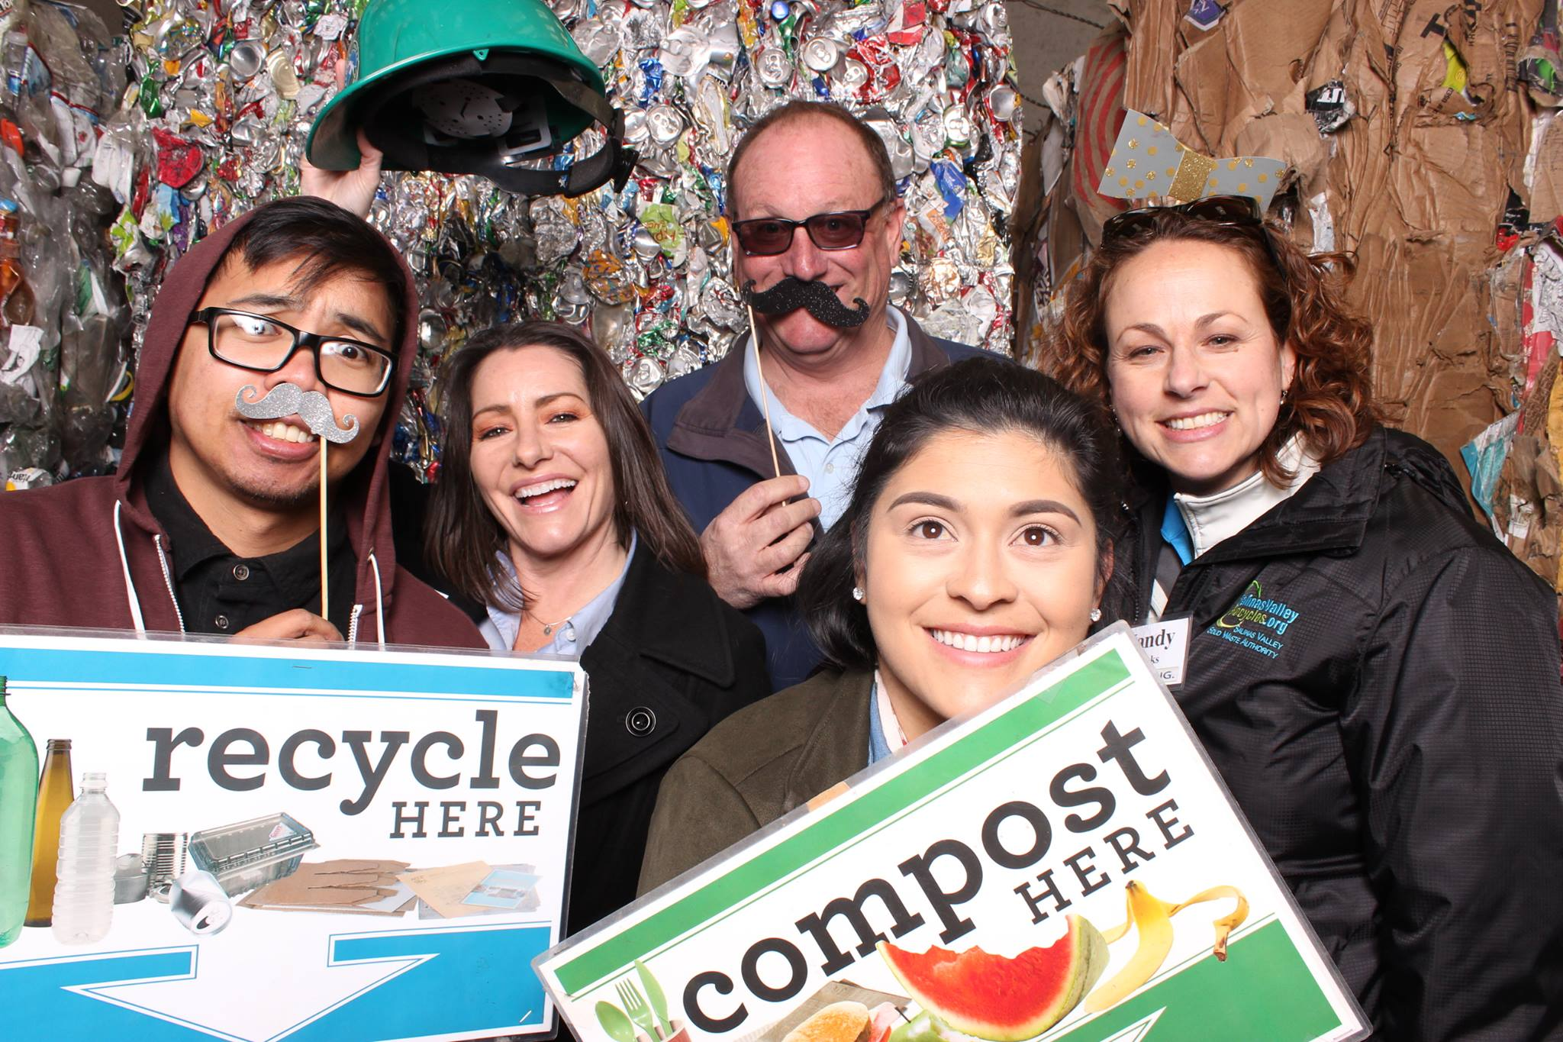
Lessons and Outcomes
Increased followers and more engagement
Don’t over advertise
Don’t boost Instagram post through Facebook
Getting people interested
Facebook
Posts | Reach |  | Engagement
 | organic | paid
Earth Day Giveaway Alert! | 341 |  | 84
Earth Day Giveaway | 638 | 517 | 159
Who would like to win | 300 | 423 | 72
Do you still want to win | 204 | 168 | 31
Page Likes
Before Giveaway | 842
End of Giveaway | 851
Page likes after giveaway | 15

